Slide 1
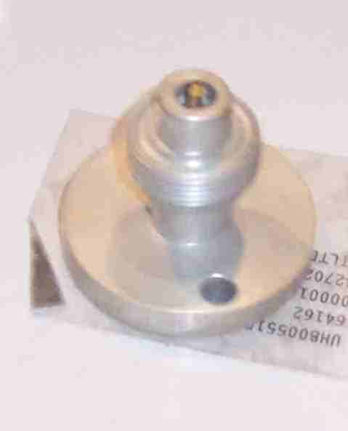
SIEMENS
HVCB SPARES
NRV at density monitor block
72.5KV,31.5KA CB
S4948812700

